Slide 1
Matthew 12:33-37 (NLT)
33 “A tree is identified by its fruit. If a tree is good, its fruit will be good. If a tree is bad, its fruit will be bad.
34You brood of snakes! How could evil men like you speak what is good and right? For whatever is in your heart determines what you say.
35A good person produces good things from the treasury of a good heart, and an evil person produces evil things from the treasury of an evil heart.
36And I tell you this, you must give an account on judgment day for every idle word you speak.
37The words you say will either acquit you or condemn you.”

Slide 2
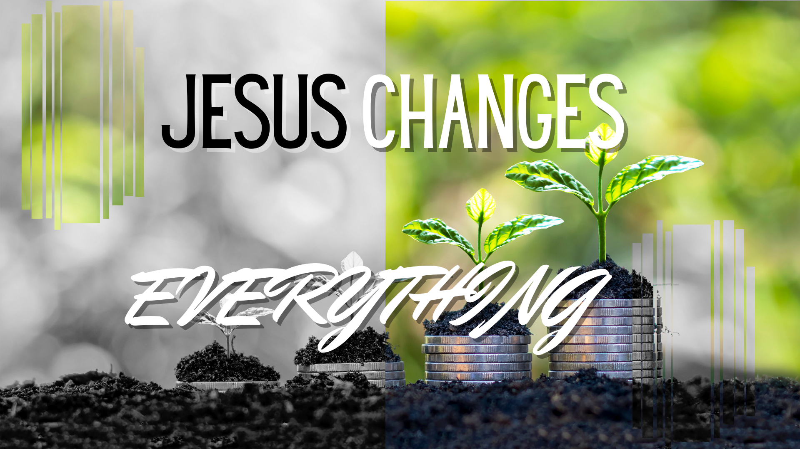

Slide 3
Matthew 12:33-37
“A tree is identified by its fruit. If a tree is good, its fruits will be good. If a tree is bad, its fruits will be bad. You brood of snakes! How could evil men like you speak what is good and right? For whatever is in your heart determines what you say. A good person produces good things from the treasury of a good heart, and an evil person produces evil things from the treasury of an evil heart. And I tell you this, you must give an account on judgment day for every idle word you speak. The words you say will either acquit you or condemn you”

Slide 4
Proverbs 4:23
Above all else guard your heart for everything you do flows from it”.
  We so often protect our physical heart but neglect our spiritual heart

Slide 5
Our Heart
PHYSICAL HEART
  Pumps blood around the body
SPIRITUAL HEART
  Our emotions, feelings
  The centre of our love and things we cherish

Slide 6
Nice house
Money
Family
Good job
HEART FILLED WITH JOY IN CHRIST, GOODNESS AND WORTH
HEART FILLED WITH DIRT
Friends
Social Status
Health

Slide 7
HEART FILLED WITH JOY IN CHRIST, GOODNESS AND WORTH
HEART FILLED WITH DIRT

Slide 8
It’s the thought that counts
Those deep down thoughts, influence our actions and our outcomes.
Are you ignoring something you should do?
Are you continuing something you should cease?

Slide 9

Would your roots sustain you against the wind and waves of life? If your surroundings were taken?

Slide 10
What are we filling our hearts with?
EVIL?
  Influences
  Sin
  Addiction
  Worry
  Control
  Anger
  Envy
GOOD?
  Gods word
  Righteousness
  Comfort in God
  Peace
  Self-Control
  Compassion
  Generosity

Slide 11
If my heart is ONLY full of goodness,
ONLY goodness can overflow

Slide 12
Guard our heart
Evaluate everything
Be wary
Know Gods word
Build strong roots

Slide 13
Is our heart murky?
FRUITS OF THE SPIRIT – Galatians 5:22-23
  Love, Joy, Peace, Patience, Kindness, Goodness, Faithfulness, Gentleness, Self-Control
Judge your internal thoughts

Slide 14
The Challenge – Pray!
reflect on your heart attitudes that were exposed to you that day and pray about those, pray that you see them, pray that God challenges them and changes them and pray to be on guard for your heart.
EXAMPLE – as you stir your iced tea, think about the trials you are going through now, and ask God to use them to reveal your heart’s attitudes. As you drink the drink, thank God for his goodness and pray for the transformation of your own heart!

